Slide 1
!! Yummy Chocolate !!
BY - Aniket Anand
Aayushman Sharma
Naman Setiya

Slide 2
"Discover the World of Yummy Chocolate"
"Discover the World of Yummy Chocolate"
Welcome to Yummy Chocolate, where indulgence meets excellence! Our website is a gateway to a world of delectable chocolate experiences. As passionate connoisseurs of fine chocolate, we have curated a selection that transcends the ordinary and promises to delight your senses.
Why Yummy Chocolate?
We named our website "Yummy Chocolate" because we want to give people a delightful and enjoyable experience with our delicious chocolates. The word "Yummy" suggests deliciousness, and when combined with "Chocolate," it creates a feeling of irresistible sweetness and quality. This name represents our passion for making top-notch chocolates that are more than just ordinary. We aim to take chocolate lovers on a memorable journey filled with premium treats.
In essence, "Yummy Chocolate" encapsulates our dedication to providing delicious and high-quality chocolate experiences, emphasizing our commitment to creating sweet and memorable moments.

Slide 3
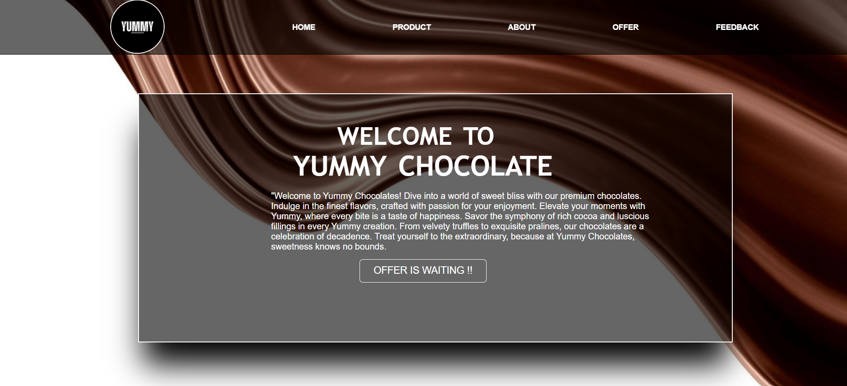
Home Page
Logo
container
Nav Bar
with Buttons
Button to
see offers

Slide 4
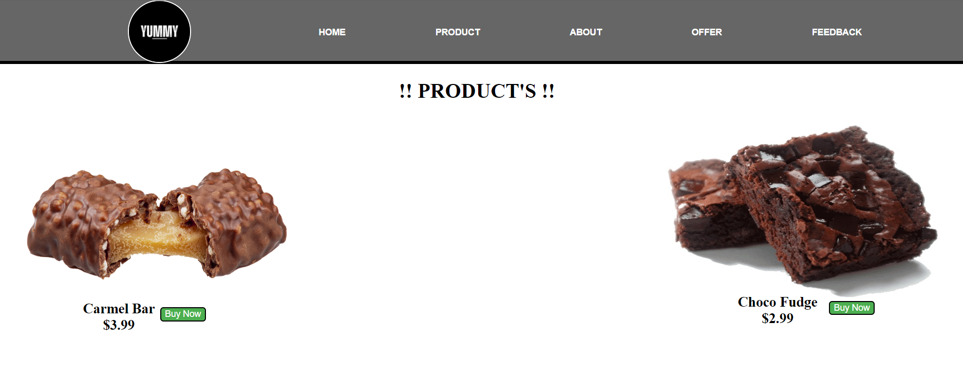
Product Page
Total 6
Images of
product
Button
for user
to buy

Slide 5
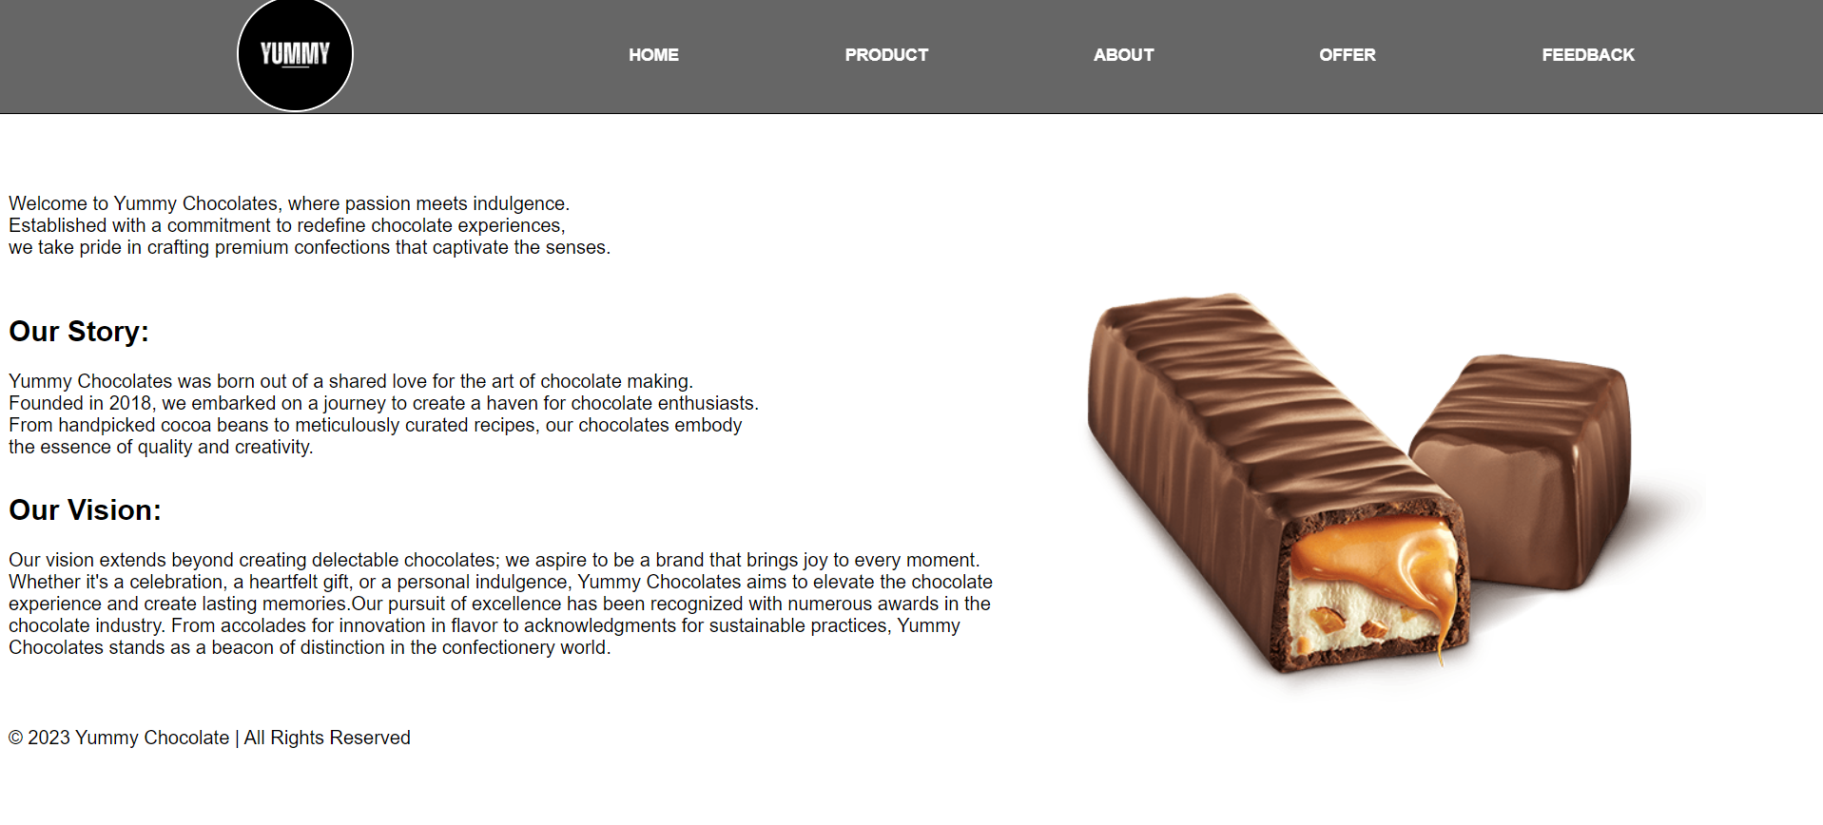
About Page
Added
Image of our
product
For reserved
rights
added footer

Slide 6
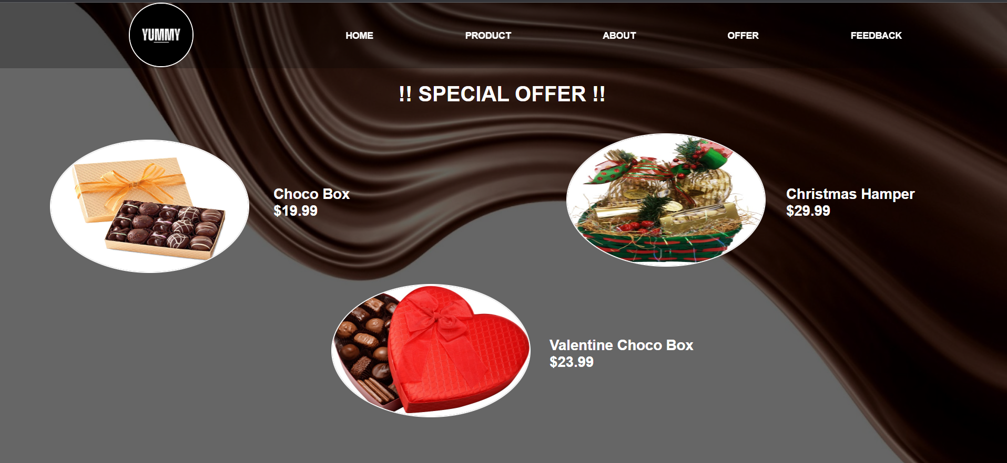
Offer Page
Added price
as well as
special names

Slide 7
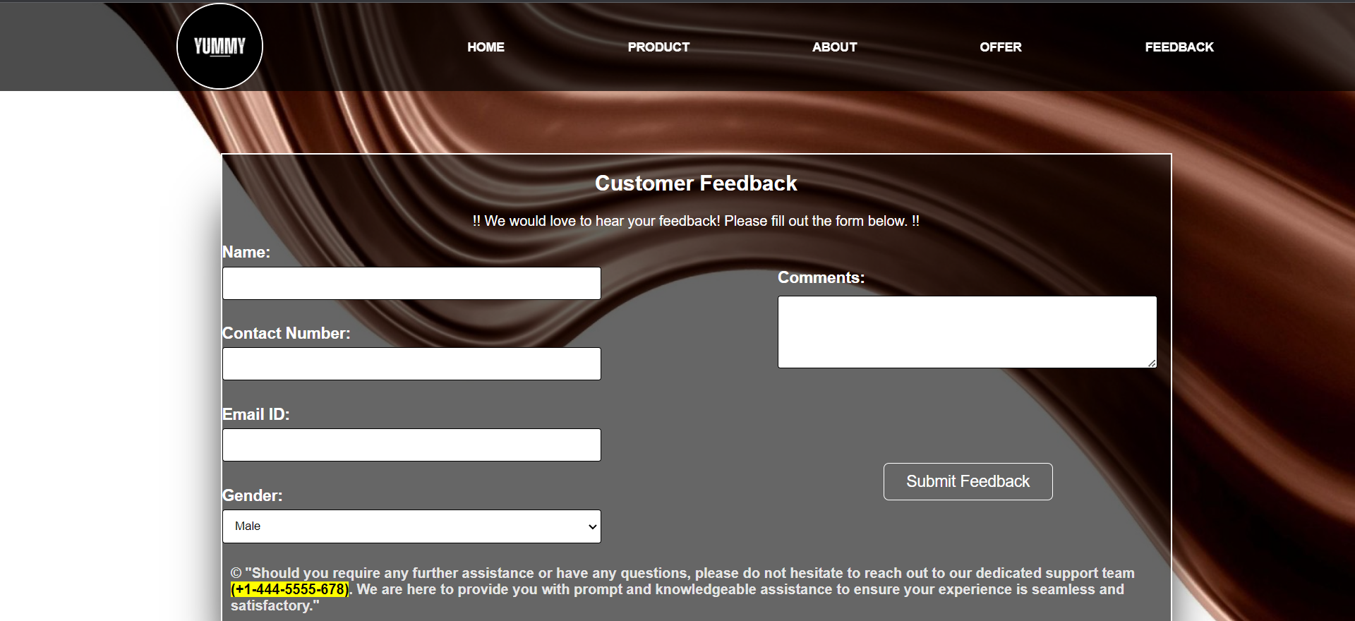
Feedback Page
Container
with form
Fill all the
Blanks
After filling
click the
Submit Button
Added
Support
team No.
in fotter

Slide 8

After Clicking on Submit button you will
be directed to this page . Thanks
for submitting your feedback .

